Slide 1


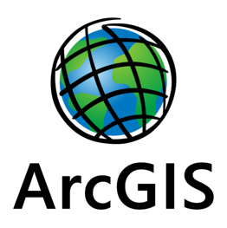
Research of optimal hydrocarbons zones in Texas, USA through Geospatial analysis of geological and economical parameters using ARCGIS
Germath MANDOKO
Dmitry SHAKHOV
Teacher: Naci Dilekli

Slide 2
Table of Contents
Introduction
Flowchart of the project
Used data
Python code
Demonstration through ARCGIS Pro
Conclusion

Slide 3
Introduction
The Oil & Gas industry is the backbone of the economy of a majority of countries. Through the years, the number of obvious easy-to-recover reservoirs has diminished, pushing the industry to explore more difficult and less improbable zones. With those new challenging zones making the traditional methods of hydrocarbon exploration less effective technically and economically, the industry needed to implement new innovative hydrocarbon exploration methods.
Geographic information systems have proven to be one of those useful tools in remote research of oil and gas.
In that optic, the aim of the present project was to find the most suitable (geologically and economically) hydrocarbons zones in Texas, USA . In order to achieve that purpose, some petrophysical and economical parameters of the studied region were analyzed using Arcgis Pro.

Slide 4
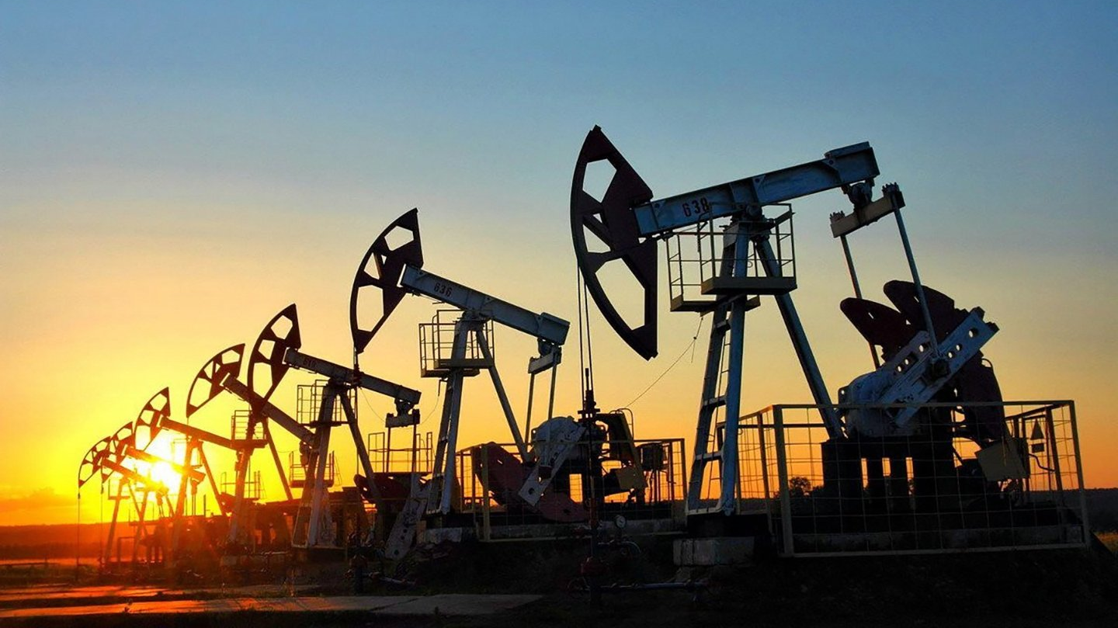
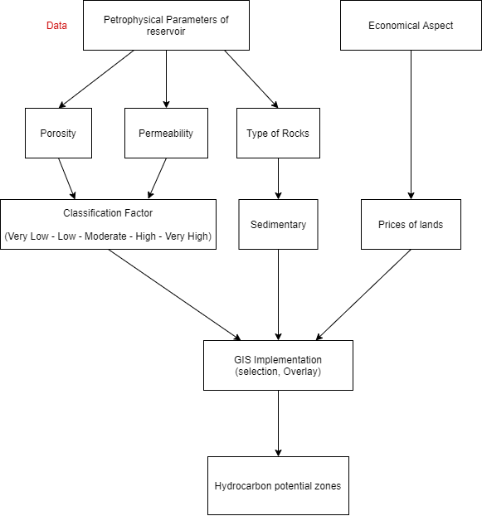
Flowchart of the Project

Slide 5
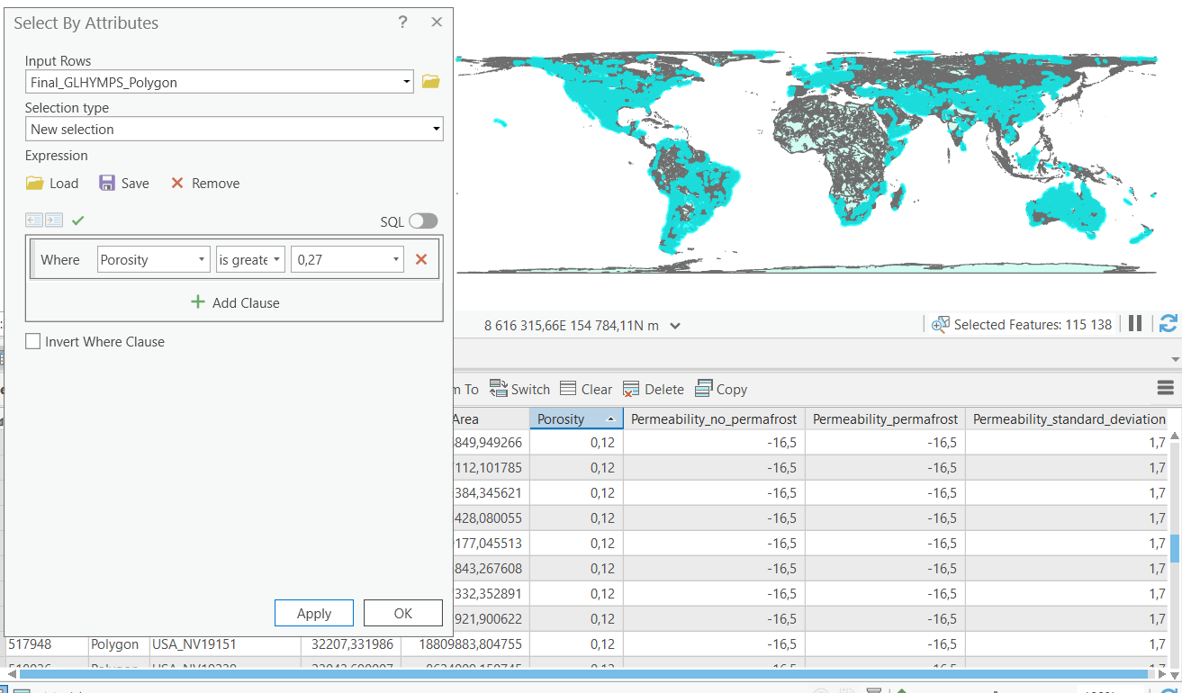
Data
Soil Porosity in the world
All the data used for this project were from open sources.
Prior to using the obtained data, a clip analysis was conducted on original maps in order to restrict the studied area to Texas.

Slide 6
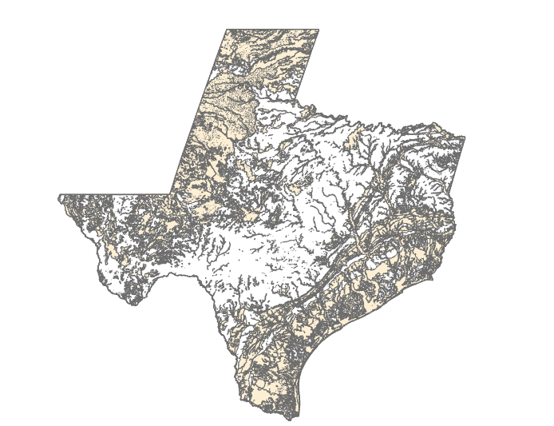
Soil Permeability
This map was extracted from the same map as the porosity one.
It shows the permeability of rocks which is an indication of the ability of fluids to flow properly through rocks: a crucial parameter in Oil reservoir engineering.

Slide 7
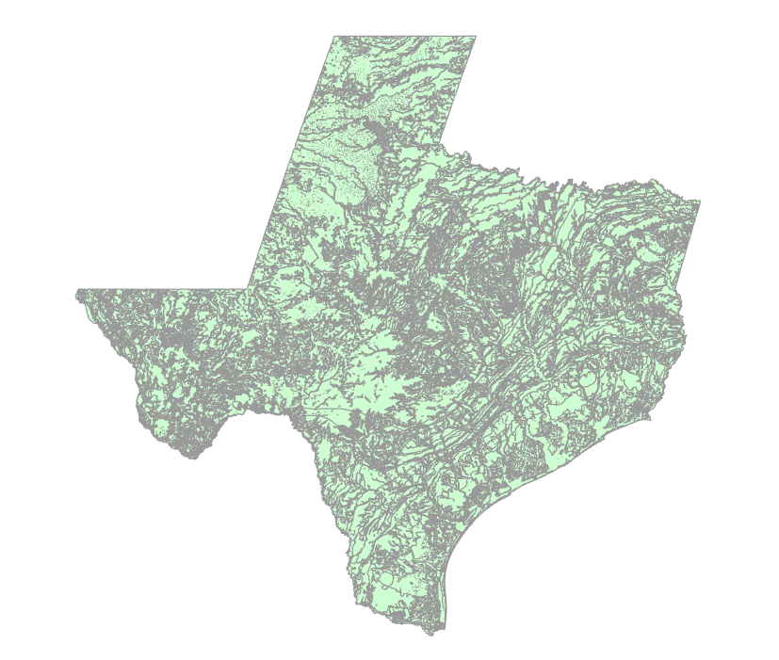
Lithology Map of Texas
A digital geologic map showing the general physical characteristics of rocks in Texas, mainly the nature of the rocks.

Slide 8
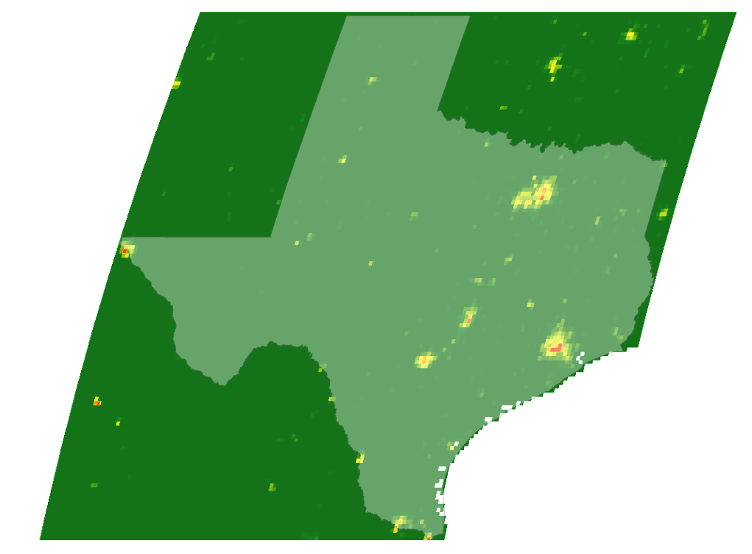
GDP map of Texas
In absence of more precise data, the Gross Domestic Product (GDP) map has been used as an indicator of the land's prices all around the state of Texas.

Slide 9
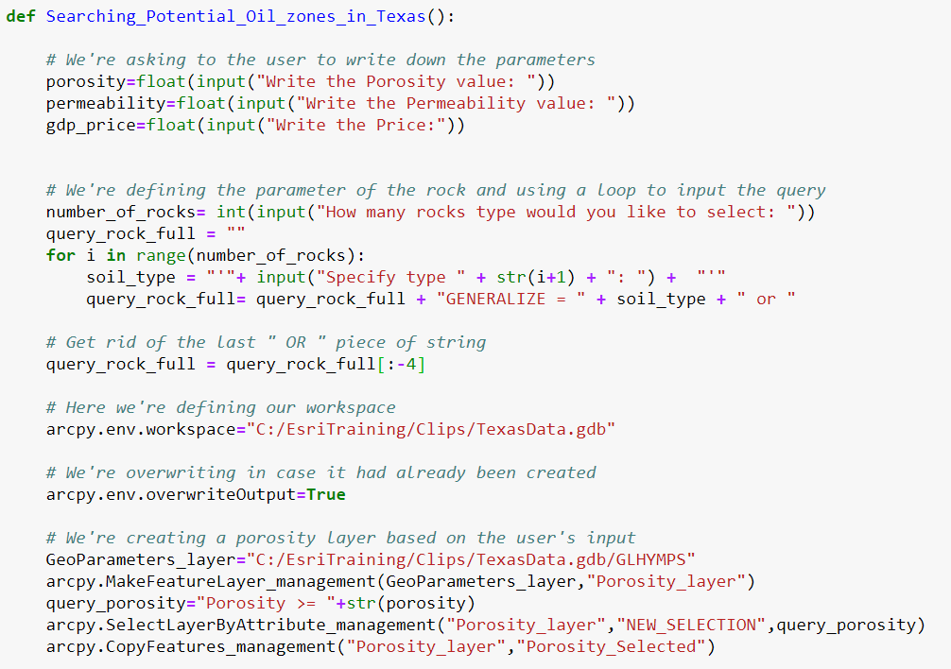
Python Code
Since we were doing repetitive operations, coding has been particularly useful for this project

Slide 10
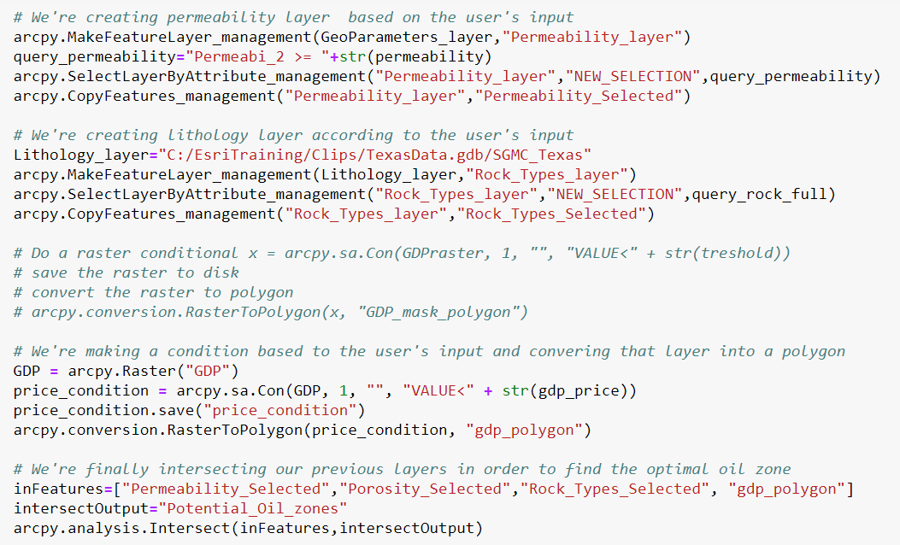

Slide 11
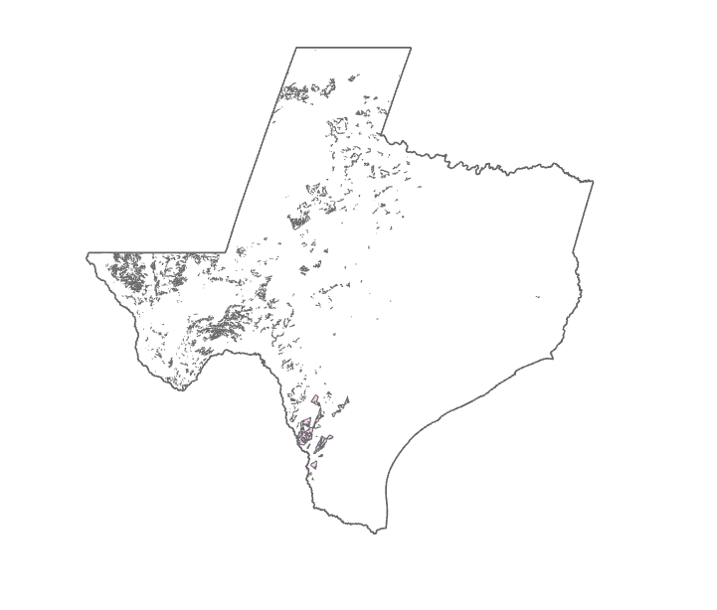
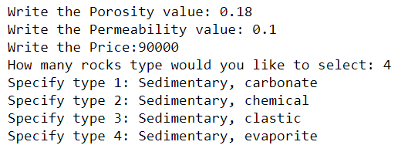
Potential Oil zones

Slide 12
Conclusion
In this project, we conducted a geospatial analysis in order to find the most suitable hydrocarbon zones in Texas. Softwares such as: Arcgis and Jupyter (for Python) were used.
The main challenge encountered all along this project was to find the data.
This analysis has showed that Geographic information systems can be used to remotely research hydrocarbons zones not only technically and economically but also can be in a certain extent environmentally, since there is no direct contact between the studied region and the used methods.

Slide 13
THANK YOU FOR YOUR ATTENTION

